Slide 1
Smart Parlour Management system
PRESENTED BY
NAME ID
SYEDA FARIHA SULTANA 19-39718-1
ATIA SULTANA MIM 19-40121-1
MD. AMIMUL AHASUN ANAS 19-40149-1
FATHEMA AKTER MOONMOON 19-40161-1
EASINUL ABEDIN SAYEM 19-40291-1

Slide 2
outline
Introduction
Product Scope
Product Perspective
Product Functions
User Classes and Characteristics
Ui/Ux Design
System Features
Non-Functional Requirements
References

Slide 3
INTRODUCTION
The name of this project is “Smart parlour management system”.
It is a digital web-based system.
This system is to give home services at the right time without any problem.
In our country many areas people could not be able to go to parlor at any moment for many reasons.
In this app, user can get services if they register an account.
Through this system, user can find nearest parlor, can get every parlour detail, location, price in one system and they can book an appointment.

Slide 4
Product Scope
An online parlour called Smart Parlour Management System targets to ease parlour management issues and to create a convenient and easy-to-use application for customer, trying to book schedule.
The system is based on a relational database with its parlour management and reservation functions.
This system will be controlled by a database server supporting in the major cities around the Bangladesh as well as thousands of parlours by various parlours details.
Above all, system provide a comfortable user experience along with the best pricing available. On this system it will give all parlour details, location, price details in one system. If anyone cannot go parlor, he or she easily get service at home with system.

Slide 5
Product Perspective
Using this platform user can view all the parlours which are partner with our parlour management system and also view their services.
Like food panda serves a similar need in the restaurant industry, but our system brings clients and parlours together online.
When customers search the parlour then the system will show all the available parlours on their locations and if by chance the time you have searched is not available then it will also show the next vacant slots on our system which is registered with our platform on that location.
It will be useful for customers because now they have their bookings with the slots available. It will also remove all the paperwork as the owner will have access to all the customers details and their records to serve them better.

Slide 6
Product Functions
Functional:
Registration
Login (Manager, Customer, Employee, Beautician, Cashier)
Non-Functional:
Security
Response time
Memory

Slide 7
User Classes and Characteristics
Manager: They will have the authority to manage or organize anything for every user. The manager will maintain the overall tasks and estimates schedule, effort, and resources.
Employees: They will do their own respective work.
Customer: They will share about the problems they are facing & take their services.
Cashier: They will see the overall software payment sections on both online or offline. They will update the payment status on time so that users can get a pleasant experience.
Beautician: They will accept or decline the service that they can provide to the customers.

Slide 8
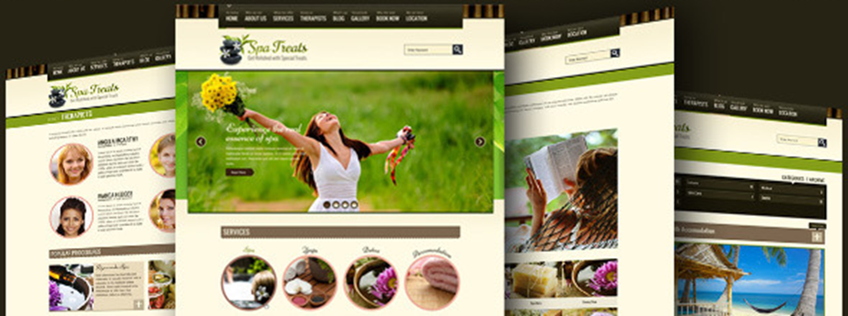
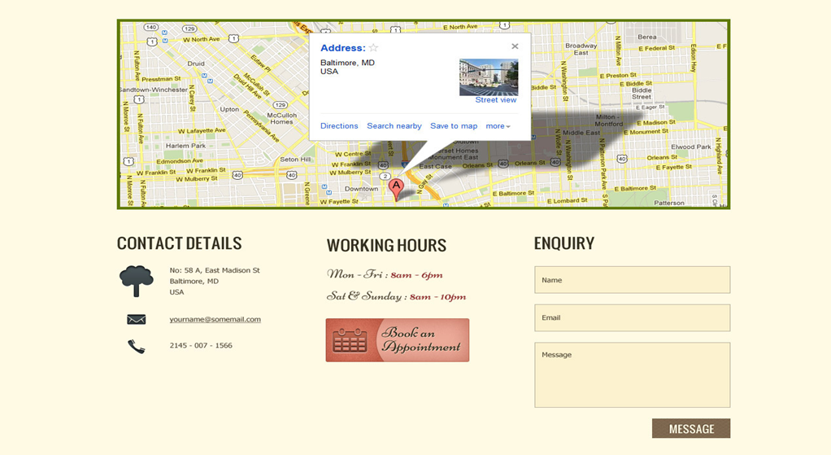
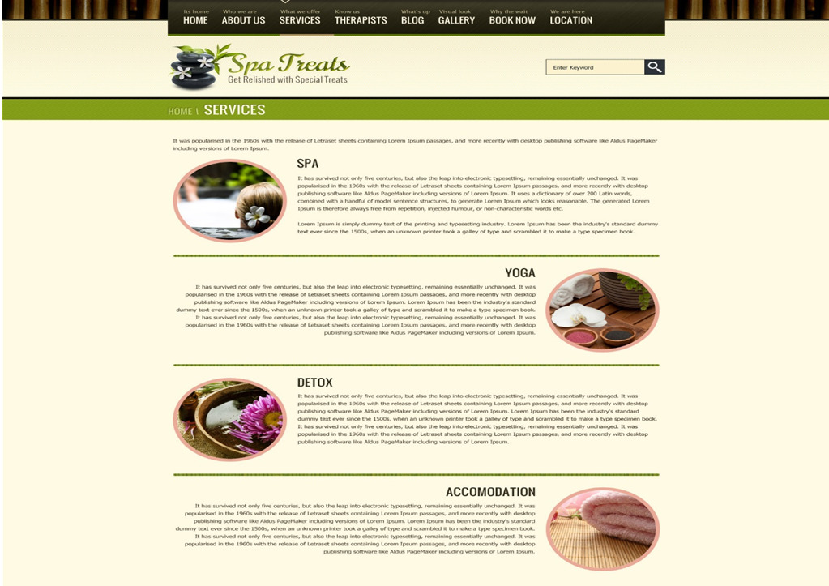
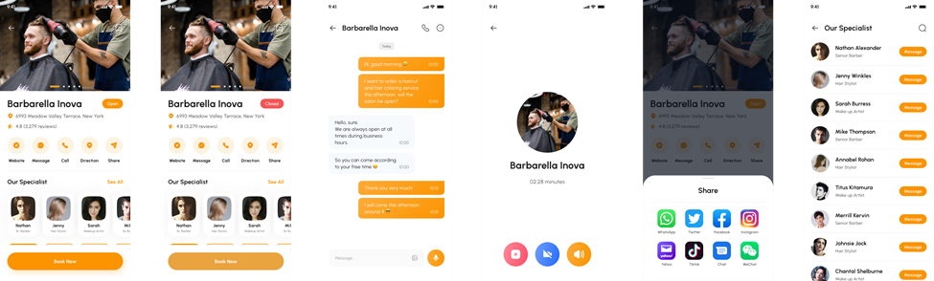
Ui/ux design

Slide 9
System features
Software Login
The user has to login to run the software and the user has to resister to create an account using user’s general information.
Background Color
System by default shows black background color to the user. But it also allows user to choose their preferred color.
After choosing the color, the user can also change it and does not need to set it up every time because it will automatically be saved.
Language
System will automatically set the language to English. But also allow the user to choose their preferred language.
After choosing the language, the user can change it. anytime and does not need to set it up every time because it will automatically be saved.

Slide 10
System features
Parlour Location And Its quality
General time will be selected according to the quality of the reviews given by the users including the location near the parlour.
Higher rate will be priority, but higher rates inability will cause the system to lower the rates choose from there.
Online/Offline appointment with Beauticians profile
Users will have the choice to select from a wide range of beautician service
Users will also have access to all the general information of the parlour or beautician they select
Payment
Users have both online and offline payment option
Users for online can booked service from our site directly
Users for offline must able pay in person

Slide 11
System features
Contact Us
User will have the ability to contact the manager at anytime
FAQ
There will be a question-and-answer section for the users any query about service and details.
Update
The app or website will get a regular system update and an occasional maintenance
Settings & Privacy
Users can update their name, phone number, email addresses. at any given time
Users have the option to delete or deactivate their account at any time
Users personal information and location will be hidden from other users.
Account Security
Users can change their password any time they want
Users will have the option to enable two-factor authentication. and get alerts about unrecognized login

Slide 12
Non-Functional Requirements
Performance Requirements
This system has no performance requirements because the end user's internet connection determines the server request and response.
Safety Requirements
Account Security is a very important feature in our system. Users can change their password any time they want. Users will have the option to enable two-factor authentication. and get alerts about unrecognized login.
Security Requirements
Users can update their name, phone number, email addresses. at any given time. Users have the option to delete or deactivate their account at any time. Users’ personal information and location will be hidden from other users.

Slide 13
Non-Functional Requirements
Software Quality Attributes
1.There may be multiple managers creating the project, all of them will have the right to create changes to the system. However, the members or other users cannot make changes.
2.The project should be open source.
3.The software interface should be flexible and user friendly
Business Rules
The system shall provide a help and support menu in all interfaces for the user to interact with the system. The user can use the system by reading help and support. The system should always be available for access at all times. The users should avoid illegal rules and protocols. Neither any admin nor members should cross the rules and regulations.

Slide 14
References
https://dl.ucsc.cmb.ac.lk/jspui/bitstream/123456789/4047/1/1420992.pdf
https://iarjset.com/upload/2017/si/NCETETE-2017/IARJSET-NCETETE%205.pdf
https://www.semanticscholar.org/paper/Prototype-Development-For-Online-Reservation-System-Maryani-Nindito/21a19f9fcebb6b505f9e386d6170b39d838d0033
https://themeforest.net/item/spa-treats-health-spa-saloon-psd/screenshots/2619042?index=0

